Slide 1

Election-Analysis.io
By Arturo Corro and Steven Barrios

Slide 2
Introduction
At Election-Analysis.io, we believe that elections are heavily influenced by factors not relating to the actual candidates themselves and more on historical trends and population behavior.
With the use of our proprietary algorithms and databases, we provide the tools necessary to analyze well known data and uncover surprising trends and correlations

Slide 3
Can You Benefit From Our Services?
If you are a...
Voter interested in political data
Political correspondent
Journalist
Author
Reporter
...You will benefit from visiting and interacting with Election-analysis.io

Slide 4
Can You Benefit From Our Services?
Even political campaigns can benefit from Election-Analysis.io. Campaign managers can use this information to better decide where to allocate resources and obtain success during elections.

Slide 5
Our Approach
At Election-Analysis.io, we believe that elections are primarily dependent on four factors...
Voter Influence
State Influence
Historical Election Influence
Party Influence
By exploring these four factors and seeing how they are as important as the actual candidates running, we can make more educated predictions on election results.

Slide 6
Functionality
Voter Influence
This section's purpose is to show the influence that voters impose on elections based on their individual data.
Here, we analyze Gross Domestic Product per capita, education level, voter eligible population, and voter race demographics.
User's have the ability to inspect yearly data by simply interacting with our graphs and seeing the correlation between data points.
State Influence
Average income per state has a direct correlation to their political affiliation which can be see given our most recent election. In this section, the user has visual representation of how which political party a state may align with according to its income.

Slide 7
Functionality (cont'd)
Historical Election Influence
Our proprietary algorithms filter and compile data from our database to show relations between two elections. Here, users can see details about elections and see the similarities between their results.
Party Influence
We have seen the two chambers of Congress, the Senate and the House of Representatives, play a huge role during the elections.
Here we let the user select any combination of parties for the President and the two chambers to see what parties were in control during their election.

Slide 8
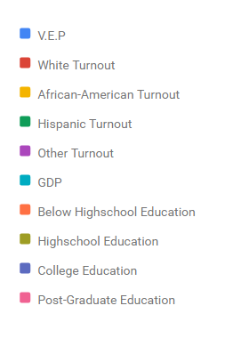
Interactive
Our user interface lets you dynamically change which data you want presented to you making it easier to interpret the data.

Slide 9
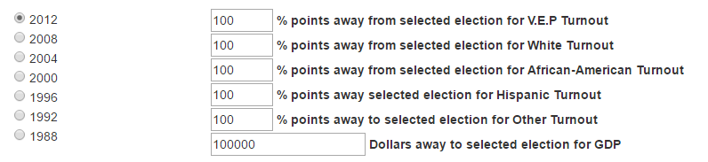
Database Access
Election-analysis.io allows for extensive manipulation of its unique database facilitating the delivery of election data.

Slide 10
What We Are Proud Of
Although some of the information we need is not as readily available as we would like, we are still able to properly inspect our four factors sufficiently and provide the necessary information.
Our interactive methods and overall positive user experience adds to the excitement of analyzing data and becoming more knowledgeable.
We are certain that users will be more informed when voting, reporting on political matters, or simply running for President of the United States of America after utilizing Election-Analysis.io.

